Slide 1
INTERACTION STYLES
Week 6

Slide 2
Interaction Styles
What is Interaction?
  Communication between the user and the system.
  Direct Manipulation

Slide 3
Interaction Styles
There are a number of common interface styles including;
  Command line interface
  Menu
  Natural language
  Question/Answer
  Continue..

Slide 4
Interaction Styles
Continue..
  Form-fill and spread sheets
  WIMP(windows, icons, menu, pointer)
  Point and click
  Three dimensional interface

Slide 5
Interaction Styles
A command line interface or CLI is a tool for interacting with computers, often using a text terminal.
CLI originated when teletype machines were connected to computers in the 1950s. Offering immediate interaction and feedback, they are an advancement over mechanical punch card technology.

Slide 6
Interaction Styles
CLI are often used by programmers and system administrators (especially in Unix-based operating systems), and by a smaller subset of technically advanced home users.
CLI are also popular among people with visual disability.

Slide 7
Interaction Styles
A program that implements such interface is often called a command line interpreter or shell.
  Examples include the various Unix shells (sh, ksh, csh, tcsh, bash, etc.),
  DOS's command.com ("Command Prompt"),

Slide 8
Interaction Styles
Anatomy of a CLI
  A CLI can generally be considered as consisting of syntax and semantics.
    The syntax is the grammar that all commands must follow.
    The semantics define what sort of operations are possible, and on what sort of data these operations can be performed.

Slide 9
Interaction Styles
It may be possible for two different CLI to agree on either syntax or semantics, but it is only when they agree on both that they can be considered sufficiently similar to allow users to use both systems without needing to relearn anything as well as enable re-use of scripts.

Slide 10
Interaction Styles
In its simplest form, a CLI displays a prompt, the user types a command on the keyboard and executes the command (usually with the Enter key), and the computer executes the command, providing textual output.

Slide 11
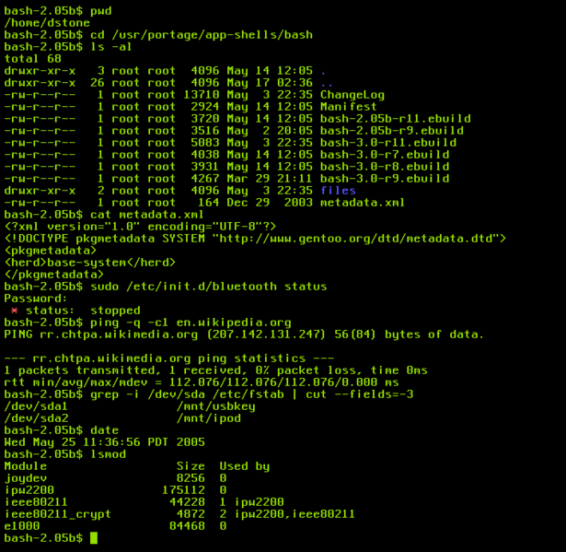
Interaction Styles

Slide 12
Interaction Styles
Menus and Navigation
  Set of options on screen for choosing the action.
  Use for selecting actions or among options for data entry.
    Pull-down menus
    Pop-up menus
    Hierarchical menus

Slide 13
Interaction Styles
In a menu-driven interface, the set of options available to the user is displayed on the screen, and
  Selected using the mouse, or numeric or alphabetic keys.

Slide 14
Interaction Styles
Menu options need to be meaningful and logically grouped to aid recognition.
  Often menus are hierarchically ordered and
    The option required is not available at the top layer of the hierarchy.

Slide 15
Interaction Styles
The grouping and naming of menu options then provides the only cue for the user to find the required option.
This is restricted form of full WIMP system.

Slide 16
Interaction Styles
Natural Language
  The most attractive means of communicating with computers.
  Users unable to remember command or lost in a hierarchy of menus.

Slide 17
Interaction Styles
Natural Language understanding, both of speech and written input, is the subject of much interest and research.
The ambiguity of natural language makes it very difficult for a machine to understand.

Slide 18
Interaction Styles
Example: unclear syntax or structure, of a phrase;
  The boy hit the dog with the stick.
    We cannot be sure whether the boy is using the stick to hit the dog or;
    Whether the dog holding the stick when it is hit.

Slide 19
Interaction Styles
Given these problems, it seem unlikely that a general natural language interface will be available for some time.
However, systems can be built to understand restricted subsets of a language.

Slide 20
Interaction Styles
Question and Answer
  Q & A dialog is a simple mechanism for providing input to an application in a specific domain.
  This user is asked a series of questions (mainly with yes/no, multiple choice) and

Slide 21
Interaction Styles
These interfaces are easy to learn and use, but
  Are limited in functionally and power.

Slide 22
Interaction Styles
Form-fills and spread sheets
  Form-filling interfaces are used primarily for data entry but
    can also be useful in data retrieval applications.

Slide 23
Interaction Styles
The user is presented with a display resembling a paper form, with slots to fill in.
Often the form display is based upon an actual form with which the user is familiar, which makes the interface easier to use.

Slide 24
Interaction Styles
Design issues
  Layout
  Sizes of fields
  Types of fields
  Help text (for the form - for each field)

Slide 25
Interaction Styles
  automatic advancement (from field to field)
  Cancel (what does it mean in the situation)
  Corrections (one field - all fields)
  Corresponding paper-form (for example order entry)
  Pre-filled fields - initial values

Slide 26
Interaction Styles
Spread sheet ?
Assignment

Slide 27
Interaction Styles
WIMP
  Stands for “Windows, Icons, Menus and Pointers”
Currently many common environments for interactive computing are example of WIMP interface style.

Slide 28
Interaction Styles
WIMP is the default interface style for the majority of interactive computer system in use today.
Example for WIMP interface include;
  Microsoft Windows for Intel PC
  Mac OS for Apple Macintosh

Slide 29
Interaction Styles
Point-and-Click Interface
  Point-and-click is the action of a computer user moving a cursor to a certain location on a screen (point) and then clicking a mouse button, usually the left one (click), or other pointing device.

Slide 30
Interaction Styles
In most multimedia systems and in web browser, virtually all actions take only a single click of the mouse button.
You may point at a city on a map and when you click a window opens, showing you tourist information about the city.

Slide 31
Interaction Styles
The point-and-click interface is not only tied to mouse-based interfaces, and is also extensively used in touch screen information system.
  In this case, it is often combined with a menu-driven interface.

Slide 32
Interaction Styles
Single-click
Double-click

Slide 33
Interaction Styles
Three-Dimensional Interface
  There is an increasing use of 3-D effects in user interface.
  The most obvious example is Virtual Reality

Slide 34
Interaction Styles
The simplest technique is where ordinary WIMP elements, buttons, scroll-bars, etc. are given a 3D appearance using
  shading,
  giving the appearance of being carve/mold out of stone.

Slide 35
Interaction Styles
There are virtual reality and information visualization systems where the use can move about within a simulated 3D world.

